Slide 1
Firewalls
jnlin

Slide 2
Firewalls
Firewall
hardware/software
choke point between secured and unsecured network
filter incoming and outgoing traffic
prevent communications which are forbidden by the security policy
What it can be used to do
Incoming: protect and insulate the applications, services and machines
Such as telnet, NetBIOS
Outgoing: limit or disable access from the internal network
Such as MSN, ssh, ftp, facebook, SC2, D3
NAT (Network Address Translation)

Slide 3
Typical Network Design

Slide 4
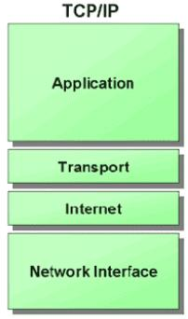
Firewalls – Capabilities
Network Layer Firewalls
Operate at a low level of TCP/IP stack as IP-packet filters.
Filter attributes
Source/destination IP
Source/destination port
TTL
Protocols
…
Application Layer Firewalls
Work on the application level of the TCP/IP stack.
Inspect all packets for improper content, a complex work!
Application Firewalls
The access control implemented by applications.
TCP Wrapper (libwrap)

Slide 5
Firewalls – Rules
Exclusive
Only block the traffic matching the rulesets
Inclusive
Only allow the traffic matching the rulesets
Offer much better control of the incoming/outgoing traffic
Safer than exclusive one
(Y) reduce the risk of allowing unwanted traffic to pass
(N) increase the risk to block yourself with wrong configuration
State
Stateful
Keep track of which connections are opened through the firewall
Be vulnerable to Denial of Service (DoS) attacks
Stateless

Slide 6
Firewalls – DMZ
Demilitarized zone (Perimeter Network)
Between untrusted and trusted networks
Limited access to internal networks
Open service to WAN (Internet)
SMTP
POP3
HTTP
VPN Servers
…
A layer of security
Limit the damage if system is compromised

Slide 7
Firewalls – Bastion Host
A workstation allow users connect to internal service
Limit the entry point of the internal network
Do logging and auditing on it
Located in DMZ or behind VPN service

Slide 8
Firewalls – Packages
Linux
iptables (kernel 2.4+)
ipchains (kernel < 2.4)
Firewalld
ufw
FreeBSD
IPFILTER (known as IPF)
IPFIREWALL (known as IPFW) + Dummynet
Packet Filter (known as PF)+ ALTQ
migrated from OpenBSD
v4.5 (In FreeBSD 9.0)
http://www.openbsd.org/faq/pf/ v5.0

Slide 9
iptables in Linux

Slide 10
iptables
User-space software that control Linux kernel firewall
Control Linux kernel Netfilter modules
Support kernel version 2.4+
Replace ipchains and ipfwadm
iptables allows system administrators to define tables containing chains of rules for the treatment of packets

Slide 11
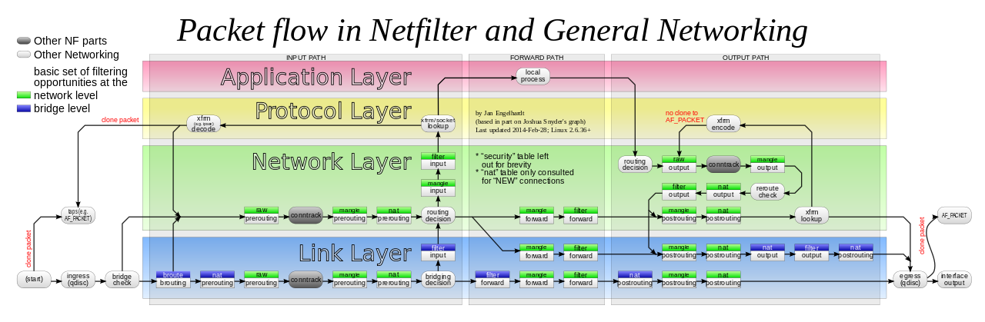
Packet flow in Netfilter

Slide 12
Xtables Architecture
Xtables
v4, v6, arp, eb
IPv4, IPv6 are different tables
Tables
filter, nat, mangle
Chains
PREROUTING, OUTPUT, FORWARD, INPUT, POSTROUTING
Rules
e.g., iptables -A INPUT -i lo -j ACCEPT

Slide 13
Xtables Architecture – Filter
Filter Table
The default table of iptables command
For packets filter
INPUT
Packets that come in (to local)
OUTPUT
Packets that go out (from local)
FORWARD
Packets that pass through (from others to others)

Slide 14
Xtables Architecture – NAT
NAT tables
For IP masquerade
PREROUTING
Packets that will go into the routing tables
POSTROUTING
Packets that have left the routing tables
OUTPUT
Packets that go out (from local)

Slide 15
Xtables Architecture – Mangle
Mangle Table
For special purpose, e.g., add or remove some special tags from packets
PREROUTING
OUTPUT
FORWARD
INPUT
POSTROUTING

Slide 16
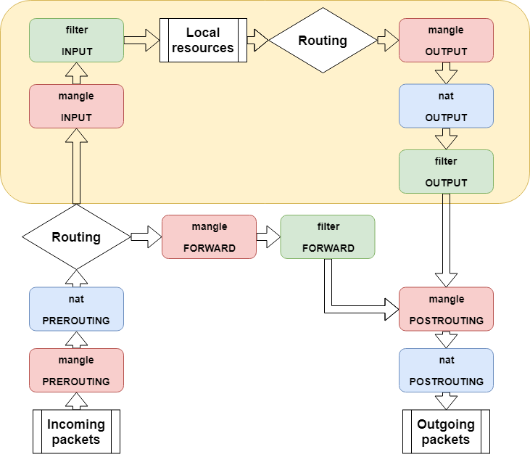
iptables Flowchart

Slide 17
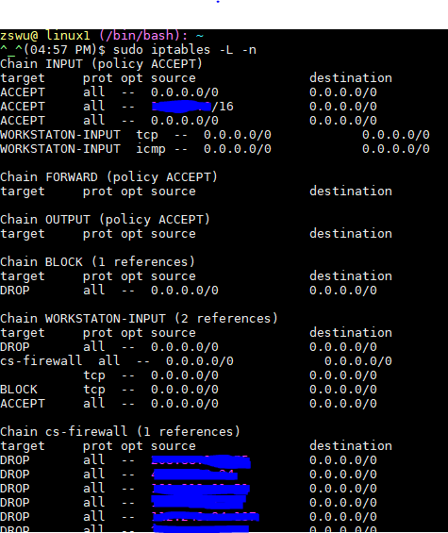
iptables – List
iptables
-t tables : Target table
-L : List all rules
-n : Don’t lookup domain names
-v : Show details

Slide 18
iptables – Init
iptables
-F : Flush all rules
-X : Flush all custom chains
-Z : Flush all statistics data for all chains
iptables
-P [INPUT,OUTPUT,FORWARD] [ACCEPT, DROP]
Change the default policy of the target chain

Slide 19
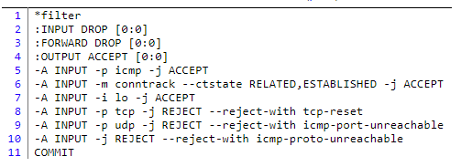
iptables – Save and Restore
iptables-restore
Restore from restore file
iptables-save
Export all rules and generate restore file
Some system will load restore file at boot
Ex: CentOS /etc/sysconfig/iptables /etc/sysconfig/ip6tables
Restore file syntax
# comments
* table name
: chain default-policy [pkt:byte]
Rules
COMMIT (End of file)

Slide 20
iptables – Module
User may need special rule to filter packets
Split several feature into different module
Stateful
Packets states tracking
Traffic statistics
Use -m to access module
iptables -A INPUT -m conntrack …
iptables -A INPUT -m recent …
http://ipset.netfilter.org/iptables-extensions.man.html

Slide 21
iptables – Rules (1/2)
Modify
-A, --append
-C, --check
-D, --delete
-I, --insert
-R, --replace
Jump
-j, --jump
To user-defined chain
ACCEPT, DROP, REJECT, RETURN, SNAT, DNAT, MASQUERADE
-g, --goto
Unlike the --jump option return will not continue processing in this chain but instead in the chain that called us via --jump.

Slide 22
iptables – Rules (2/2)
Filter
-i, -o [if] : incoming interface / outgoing interface
-i ens192 -o docker0
-s, -d [net] : Source / Destination
-s 192.168.0.1/24 –d 140.113.1.1
--sport, --dport [port] : Source port / Destination port
--sport 22 --dport 80
-p [protocol] : tcp, udp, icmp, all
-p icmp
! (not) : Invert matching
! -s 140.113.1.0/24
! -i eth0
! -p udp

Slide 23
iptables – Custom chain
Create
-N my-chain
Define in restore file
When iptables reaches the end of user-defined chain, flow returns to the next rule in the calling chain
Ex
-A INPUT -j badguy
-A INPUT -j ACCEPT
-A badguy -s 1.2.3.4 -j DROP
-A badguy -s 140.112.0.0/24 -j DROP
…

Slide 24
Example: Hello world
Allow outgoing packets but deny all incoming packets, except the packets that reply users requests
-A INPUT -i lo -j ACCEPT
-A INPUT -m conntrack --ctstate RELATED,ESTABLISHED -j ACCEPT
State
NEW : New connection
ESTABLISHED : Old connection
RELATED : New connection create by ESTABLISHED session
INVALID

Slide 25
Example: NAT
Provides NAT from eth0 to eth1
sysctl -w net.ipv4.ip_forward=1
-t NAT -A POSTROUTING -i eth0 -o eth1 -j MASQUERADE
Nat
SNAT --to-source : Change Source IP Address
DNAT --to-destination : Change Destination IP Address
MASQUERADE : Change Source IP Address (based on outgoing device IP Address)

Slide 26
Example: Prevent DDoS Attack
Append traffic limit (10 times / 60 sec) to SSH services
-A INPUT -p tcp --dport 22 -m state --state NEW -m recent --set --name RECENT --rsource
-A INPUT -p tcp --dport 22 -m state --state NEW -m recent --rcheck --seconds 60 --hitcount 10 --name RECENT --rsource -j DROP
xt_recent
Record every connection
Filter connection by connecting history

Slide 27
Other tools
These tools help user to manage iptables rules
UFW (Uncomplicated Firewall) (Ubuntu)
Easy to use
Hard to customize
Firewalld (Redhat)
Another way to manage your firewall
Sometime even with these tools, you still need to understand iptables, otherwise you cannot manage complicated firewall rules like docker network, kubernetes

Slide 28
PF in FreeBSD

Slide 29
Packet Filter (PF)
Functionality
Filtering packets
NAT
Load balance
QoS: (ALTQ: Alternate Queuing)
Failover (pfsync + carp)

Slide 30
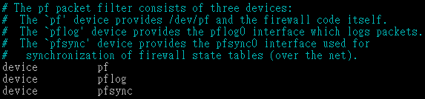
PF in FreeBSD – Enable pf*
In /etc/rc.conf (kernel modules loaded automatically)
pf_enable="YES"
pflog_enable="YES"
pfsync_enable="YES"
Kernel configurations
device pf
device pflog
device pfsync

Slide 31
PF in FreeBSD – Commands
/etc/rc.d/pf
start / stop / restart / status / check / reload / resync
pfctl
-e / -d
-F {nat | rules | state | info | Tables | all | …}
-v -s {nat | rules | state | info | all | Anchors | Tables | …}
-v -n -f /etc/pf.conf
-t <table> -T {add | delete| test} {ip …}
-t <table> -T {show | kill | flush | …}
-k {host | network} [-k {host | network}]
-a {anchor} …
Default anchor: -a '*'
Ex. -a ‘ftp-proxy/*’
Notes:
start: flush all, and load config
reload: flush everything w/o existing state entries, and load config
restart: stop start
resync: just load config

Slide 32
PF in FreeBSD – Config ordering
Macros
user-defined variables, so they can be referenced and changed easily.
Tables “table”
similar to macros, but efficient and more flexible for many addresses.
Options “set”
tune the behavior of pf, default values are given.
Normalization “scrub”
reassemble fragments and resolve or reduce traffic ambiguities.
Queueing “altq”, “queue”
rule-based bandwidth control.
Translation (NAT) “rdr”, “nat”, “binat”
specify how addresses are to be mapped or redirected to other addresses
First match rules
Filtering “antispoof”, “block”, “pass”
rule-based blocking or passing packets
Last match rules

Slide 33
PF in FreeBSD – Lists
Lists
Allow the specification of multiple similar criteria within a rule
multiple protocols, port numbers, addresses, etc.
defined by specifying items within { } brackets.
eg.
pass out on rl0 proto { tcp, udp } from { 192.168.0.1, 10.5.32.6 } to any
pass in on fxp0 proto tcp to port { 22 80 }
Pitfall
pass in on fxp0 from { 10.0.0.0/8, !10.1.2.3 }
You mean (It means) 1. pass in on fxp0 from 10.0.0.0/8 2. block in on fxp0 from 10.1.2.3 2. pass in on fxp0 from !10.1.2.3
Use table, instead.

Slide 34
PF in FreeBSD – Macros
Macros
user-defined variables that can hold IP addresses, port numbers, interface names, etc.
reduce the complexity of a pf ruleset and also make maintaining a ruleset much easier.
Naming: start with [a-zA-Z] and may contain [a-zA-Z0-9_]
eg.
ext_if = "fxp0“
block in on $ext_if from any to any
Macro of macros
host1 = "192.168.1.1“
host2 = "192.168.1.2“
all_hosts = "{" $host1 $host2 "}"

Slide 35
PF in FreeBSD – Tables (1)
Tables
used to hold a group of IPv4 and/or IPv6 addresses
hostname, inteface name, and keyword self
Lookups against a table are very fast and consume less memory and processor time than lists
Two attributes
persist: keep the table in memory even when no rules refer to it
const: cannot be changed once the table is created
eg.
table <private> const { 10/8, 172.16/12, 192.168/16 }
table <badhosts> persist
block on fxp0 from { <private>, <badhosts> } to any
table <spam> persist file "/etc/spammers" file "/etc/openrelays"

Slide 36
PF in FreeBSD – Tables (2)
Tables – Address Matching
An address lookup against a table will return the most narrowly matching entry
eg.
table <goodguys> { 172.16.0.0/16, !172.16.1.0/24, 172.16.1.100 }
block in on dc0
pass in on dc0 from <goodguys>
Result
172.16.50.5 passed
172.16.1.25 blocked
172.16.1.100 passed
10.1.4.55 blocked

Slide 37
PF in FreeBSD – Options
Format
control pf's operation, and specified in pf.conf using “set”
Format: set option [sub-ops] value
Options
loginterface – collect packets and gather byte count statistics
ruleset-optimization – ruleset optimizer
none, basic, profile
basic: remove dups, remove subs, combine into a table, re-order rules
block-policy – default behavior for blocked packets
drop, return
skip on {ifname} – interfaces for which packets should not be filtered.
eg. set skip on lo0
timeout, limit, optimization, state-policy, hostid, require-order, fingerprints, debug

Slide 38
PF in FreeBSD – Normalization
Traffic Normalization
IP fragment reassembly
scrub in all
Default behavior
Fragments are buffered until they form a complete packet, and only the completed packet is passed on to the filter.
Advantage: filter rules have to deal only with complete packets, and ignore fragments.
Disadvantage: caching fragments is the additional memory cost
The full reassembly method is the only method that currently works with NAT.

Slide 39
PF in FreeBSD – Translation (1)
Translation
Modify either the source or destination address of the packets
The translation engine
modifies the specified address and/or port in the packet
passes it to the packet filter for evaluation
Filter rules filter based on the translated address and port number
Packets passed directly if the pass modifier is given in the rule

Slide 40
PF in FreeBSD – Translation (2)
Various types of translation
binat – bidirectional mapping between an external IP netblock and an internal IP netblock
binat on $ext_if from 10.1.2.150 to any -> 140.113.235.123
binat on $ext_if from 192.168.1.0/28 to any -> 140.113.24.0/28
nat – IP addresses are to be changes as the packet traverses the given interface
no nat on $ext_if from 192.168.123.234 to any
nat pass on $ext_if from 192.168.123.0/24 to any -> 140.113.235.21
rdr – redirect packets to another destination and possibly different port
no rdr on $int_if proto tcp from any to $server port 80
rdr on $int_if proto tcp from any to any port 80 -> 127.0.0.1 port 80
Notes:
Port range rdr

Slide 41
PF in FreeBSD – Translation (3)
Evaluation
Evaluation order of translation rules depends on the type
binat rules first, and then either rdr rules for inbound packets or nat rules for outbound packets
Rules of the same type are evaluated in the order of appearing in the ruleset
The first matching rule decides what action is taken
If no rule matches the packet, it is passed to the filter unmodified

Slide 42
PF in FreeBSD – Packet Filtering (1)
pf has the ability to block and pass packets based on
layer 3(ip, ip6) and layer 4(icmp, icmp6, tcp, udp) headers
Each packet processed by the filter
The filter rules are evaluated in sequential order
The last matching rule decides what action is taken
If no rule matches the packet, the default action is to pass
Format
{pass | block [drop | return]} [in | out] [log] [quick] [on ifname] … {hosts} …
The simplest to block everything by default: specify the first filter rule
block all

Slide 43
PF in FreeBSD – Packet Filtering (2)
States
If the packet is passed, state is created unless the no state is specified
The first time a packet matches pass, a state entry is created
For subsequent packets, the filter checks whether each matches any state
For TCP, also check its sequence numbers
pf knows how to match ICMP replies to states
Port unreachable for UDP
ICMP echo reply for echo request
…
Stores in BST for efficiency

Slide 44
PF in FreeBSD – Packet Filtering (3)
Parameters
in | out – apply to imcoming or outgoing packets
log - generate log messages to pflog (pflog0, /var/log/pflog)
Default: the packet that establishes the state is logged
quick – the rule is considered the last matching rule
on ifname – apply only on the particular interface
inet | inet6 – apply only on this address family
proto {tcp | udp | icmp | icmp6} – apply only on this protocol

Slide 45
PF in FreeBSD – Packet Filtering (4)
Parameters
hosts : { from host [ port [op] # ] to host [port [op] #] | all }
host:
host can be specified in CIDR notation, hostnames, interface names, table, or keywords any, self, …
Hostnames are translated to address(es) at ruleset load time.
When the address of an interface or hostname changes, the ruleset must be reloaded
When interface name is surrounded by (), the rule is automatically updated whenever the interface changes its address
port:
ops: unary(=, !=, <, <=, >, >=), and binary(:, ><, <>)
eg.
block in all
pass in proto tcp from any port < 1024 to self port 33333:44444

Slide 46
PF in FreeBSD – Packet Filtering (5)
Parameters
flags {<a>/<b> | any} – only apply to TCP packets
Flags: (F)IN, (S)YN, (R)ST, (P)USH, (A)CK, (U)RG, (E)CE, C(W)R
Check flags listed in <b>, and see if the flags (not) in <a> is (not) set
eg.
flags S/S : check SYN is set, ignore others.
flags S/SA: check SYN is set and ACK is unset., ignore others
Default flags S/SA for TCP
icmp-type type code code
icmp6-type type code code
Apply to ICMP and ICMP6 packets
label – for per-rule statistics
{tag | tagged} string
tag by nat, rdr, or binat, and identify by filter rules.

Slide 47
PF in FreeBSD – Load Balance
Load balance
For nat and rdr rules
eg.
rdr on $ext_if proto tcp from any to any port 80 \ -> {10.1.2.155, 10.1.2.160, 10.1.2.161} round-robin

Slide 48
PF in FreeBSD – Security
For security consideration
state modulation
Create a high quality random sequence number
Applying modulate state parameter to a TCP connection
syn proxy
pf itself completes the handshake
Applying synproxy state parameter to a TCP connection
Include modulate state

Slide 49
PF in FreeBSD – Stateful tracking
Stateful tracking options
keep state, modulate state, and synproxy state support these options
keep state must be specidied explicitly to apply options to a rule
eg.
table <bad_hosts> persist
block quick from <bad_hosts>
pass in on $ext_if proto tcp to ($ext_if) port ssh keep state \ ( max-src-conn-rate 5/30, overload <bad_hosts> flush global)

Slide 50
PF in FreeBSD – Blocking spoofed
Blocking spoofed traffic
antispoof for ifname
antispoof for lo0
block drop in on ! lo0 inet from 127.0.0.1/8 to any
block drop in on ! lo0 inet6 from ::1 to any
antispoof for wi0 inet (IP: 10.0.0.1, netmask 255.255.255.0)
block drop in on ! wi0 inet from 10.0.0.0/24 to any
block drop in inet from 10.0.0.1 to any
Pitfall:
Rules created by the antispoof interfere with packets sent over loopback interfaces to local addresses. One should pass these explicitly.
set skip on lo0

Slide 51
PF in FreeBSD – Anchors
Besides the main ruleset, pf can load rulesets into anchor attachment points
An anchor is a container that can hold rules, address tables, and other anchors
The main ruleset is actually the default anchor
An anchor can reference another anchor attachment point using
nat-anchor
rdr-anchor
binat-anchor
anchor
load anchor <name> from <file>

Slide 52
PF in FreeBSD – Example
Ex.
# macro definitions
extdev='fxp0‘
server_ext=‘140.113.214.13’
# options
set limit { states 10000, frags 5000 }
set loginterface $extdev
set block-policy drop
set skip on lo0
# tables
table <badhosts> persist file “/etc/badhosts.list”
# filtering rules
block in all
pass out all
antispoof for $extdev
block log in on $extdev proto tcp from any to any port {139, 445}
block log in on $extdev proto udp from any to any port {137, 138}
block on $extdev quick from <badhosts> to any
pass in on $extdev proto tcp from 140.113.0.0/16 to any port {139, 445}
pass in on $extdev proto udp from 140.113.0.0/16 to any port {137, 138}

Slide 53
PF in FreeBSD – Debug by pflog
Enable pflog in /etc/rc.conf (pflog.ko loaded automatically)
pflog_enable="YES"
Log to pflog0 interface
tcpdump -i pflog0
pflog_logfile="/var/log/pflog"
tcpdump -r /var/log/pflog
Create firewall rules
Default configuration rules
pf_rules="/etc/pf.conf"
Sample files
/usr/share/examples/pf/*

Slide 54
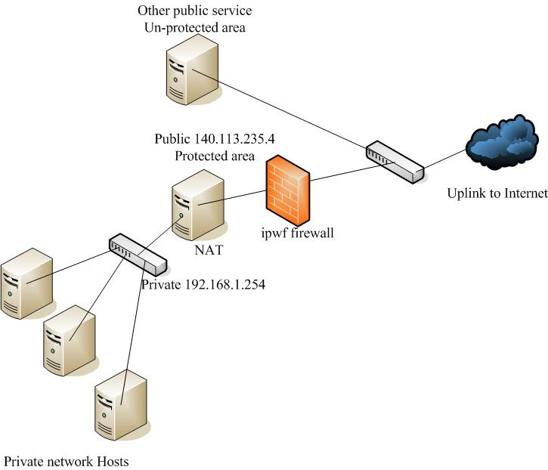
NAT on FreeBSD (1)
Setup
Network topology
configuration
Advanced redirection configuration
192.168.1.1
Web server
192.168.1.2
Ftp Server
192.168.1.101
PC1

Slide 55
NAT on FreeBSD (2)
In /etc/rc.conf
ifconfig_fxp0="inet 140.113.235.4"
ifconfig_fxp1="inet 192.168.1.254/24"
defaultrouter="140.113.235.254"
gateway_enable="YES"
In /etc/pf.conf
nat
rdr
binat
# macro definitions
extdev='fxp0‘
intranet='192.168.1.0/24‘
webserver=‘192.168.1.1’
ftpserver=‘192.168.1.2’
winxp=‘192.168.1.101’
server_int=‘192.168.1.88’
server_ext=‘140.113.235.13’
# nat rules
nat on $extdev inet from $intranet to any -> $extdev
rdr on $extdev inet proto tcp to port 80 -> $webserver port 80
rdr on $extdev inet proto tcp to port 443 -> $webserver port 443
rdr on $extdev inet proto tcp to port 21 -> $ftpserver port 21
rdr on $extdev inet proto tcp to port 3389 -> $winxp port 3389
binat on $extdev inet from $server_int to any -> $server_ext
Notes:
gateway_enable="YES"

Slide 56
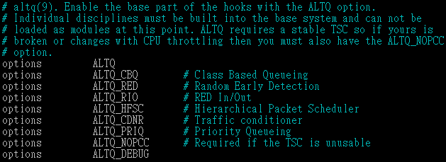
ALTQ: Alternate Queue – (1)
Rebuild Kernel is needed
http://www.freebsd.org/doc/handbook/firewalls-pf.html
ALTQ related kernel options and supported devices
man 4 altq
ipchains

Slide 57
ALTQ: Alternate Queue – (2)
altq on dc0 cbq bandwidth 5Mb queue {std, http}
queue std bandwidth 10% cbq(default)
queue http bandwidth 60% priority 2 cbq(borrow) {employee,developer}
queue developers bandwidth 75% cbq(borrow)
queue employees bandwidth 15%
block return out on dc0 inet all queue std
pass out on dc0 inet proto tcp from $developerhosts to any port 80 queue developers
pass out on dc0 inet proto tcp from $employeehosts to any port 80 queue employees
pass out on dc0 inet proto tcp from any to any port 22
pass out on dc0 inet proto tcp from any to any port 25

